Slide 1


Ad-Hoc Insights
Consumer goods
Presented by : Amritpal Singh

Slide 2

Content
1. Company Overview 2. Problem statement 3. Dataset and model 4. Ad-hoc requests , output and insights 5. Recommendations

Slide 3
Company Overview
AtliQ Hardwares (imaginary company) is one of the leading computer hardware producers in India and well expanded in other countries too.

Slide 4
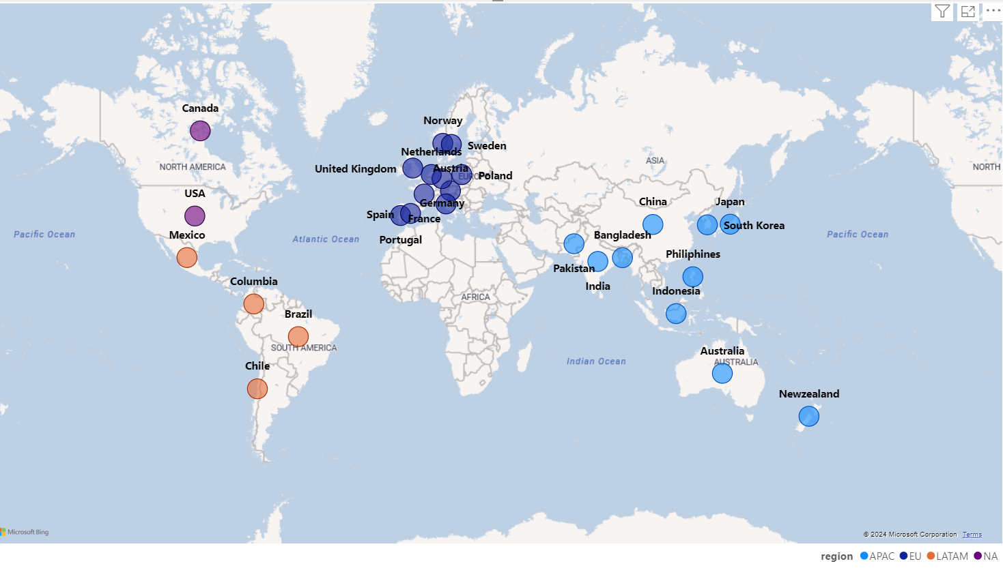
Markets

Slide 5
Product Line
Desktop
0
Peripherals
0
1
6
Internal HDD
Graphic Card
Processors
MotherBoard
Business Laptop
Personal Desktop
PC
Notebook
P & A
0
Accessories
5
2
0
Products
Personal Laptop
Business Laptop
Gaming Laptop
Mouse
Keyboard
Batteries
N & S
0
Networking
Storage
4
3
0
Wi fi extender
External Solid State Drives
USB Flash Drives

Slide 6


Problem Statement
Management noticed a lack of insights for quick, smart data-informed decisions.
Decision made to expand the data analytics team with several junior data analysts.
Tony Sharma, the data analytics director, seeks candidates with strong tech and soft skills.
To evaluate these skills, Tony decided to conduct a SQL challenge.

Slide 7
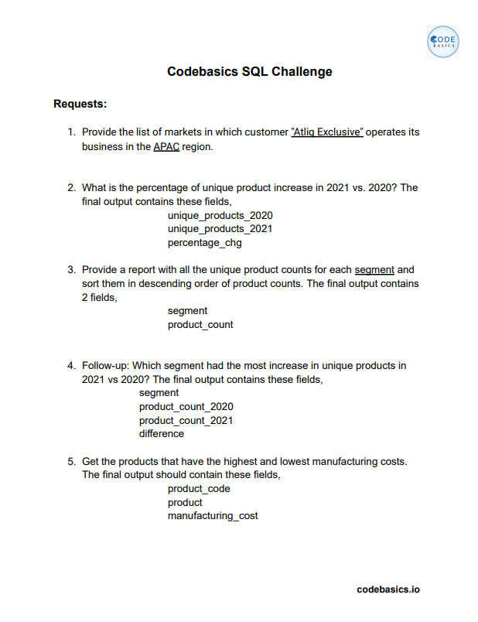

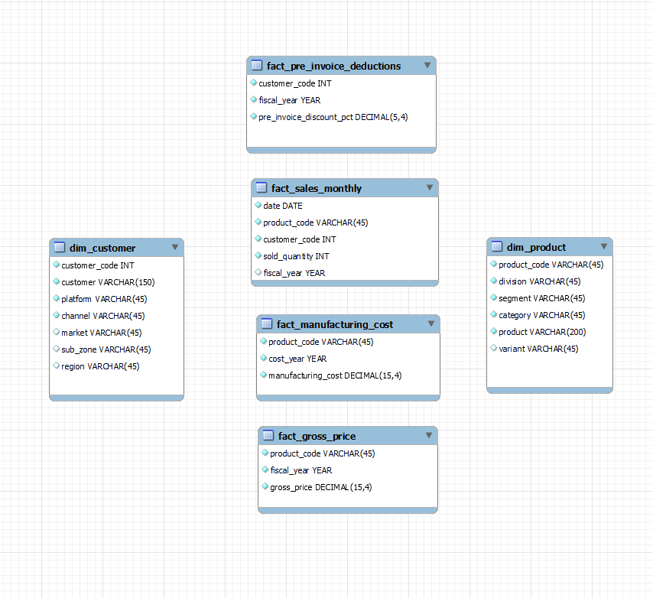
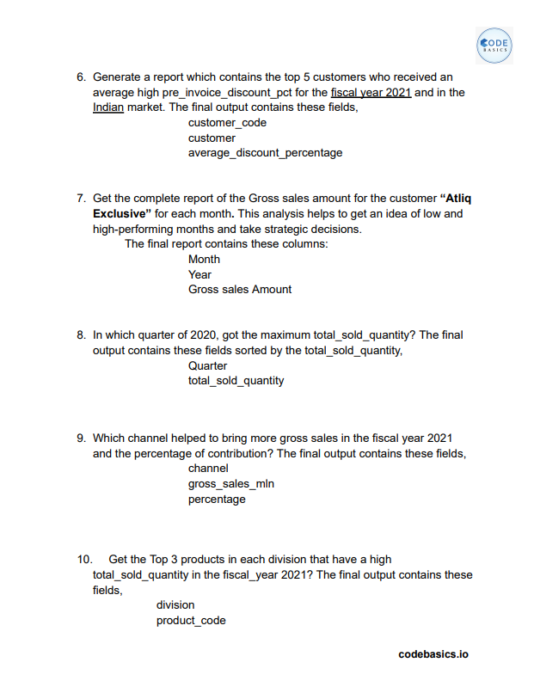
Dataset

Slide 8
Ad-hoc requests , output and insights
Requests 1. Provide the list of markets in which customer "AtliQ Exclusive" operates its business in the APAC region.
Input
select distinct market from dim_customer where customer = "AtliQ exclusive“ and region = "APAC“ ;

Slide 9
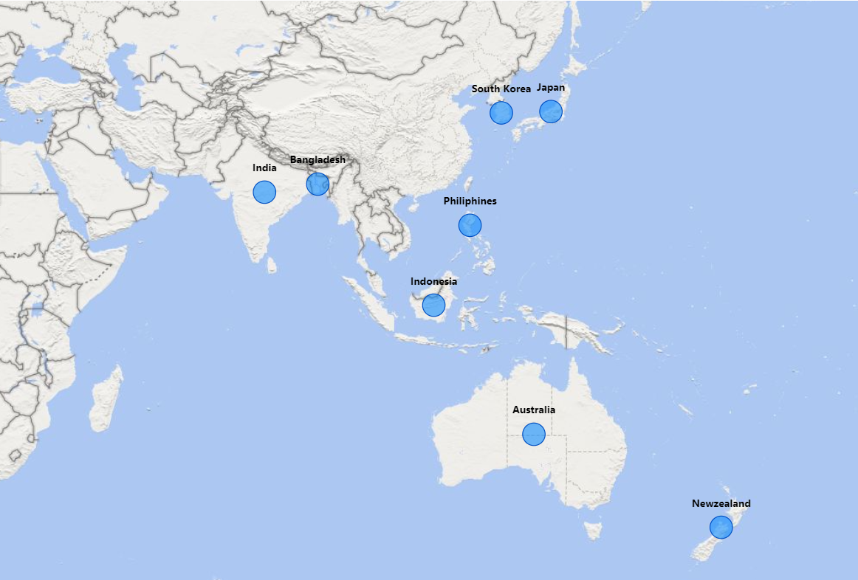
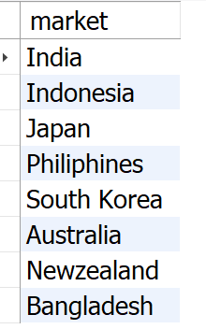
Output
Insight
AtliQ Exclusive operates in eight countries within the APAC region, demonstrating a significant regional market presence.

Slide 10
What is the percentage of unique product increase in 2021 vs. 2020? The final output contains these fields, unique_products_2020, unique_products_2021, percentage_chg .
Requests 2.
with cte1 as (
select count(distinct product_code) as unique_product_2020
from fact_sales_monthly
where fiscal_year = 2020
),
cte2 as (
select count(distinct product_code) as unique_product_2021
from fact_sales_monthly
where fiscal_year = 2021
)
select
unique_product_2020, unique_product_2021,
(unique_product_2021-unique_product_2020)*100/unique_product_2020 as pct_change
from cte1
cross join cte2;
Input

Slide 11
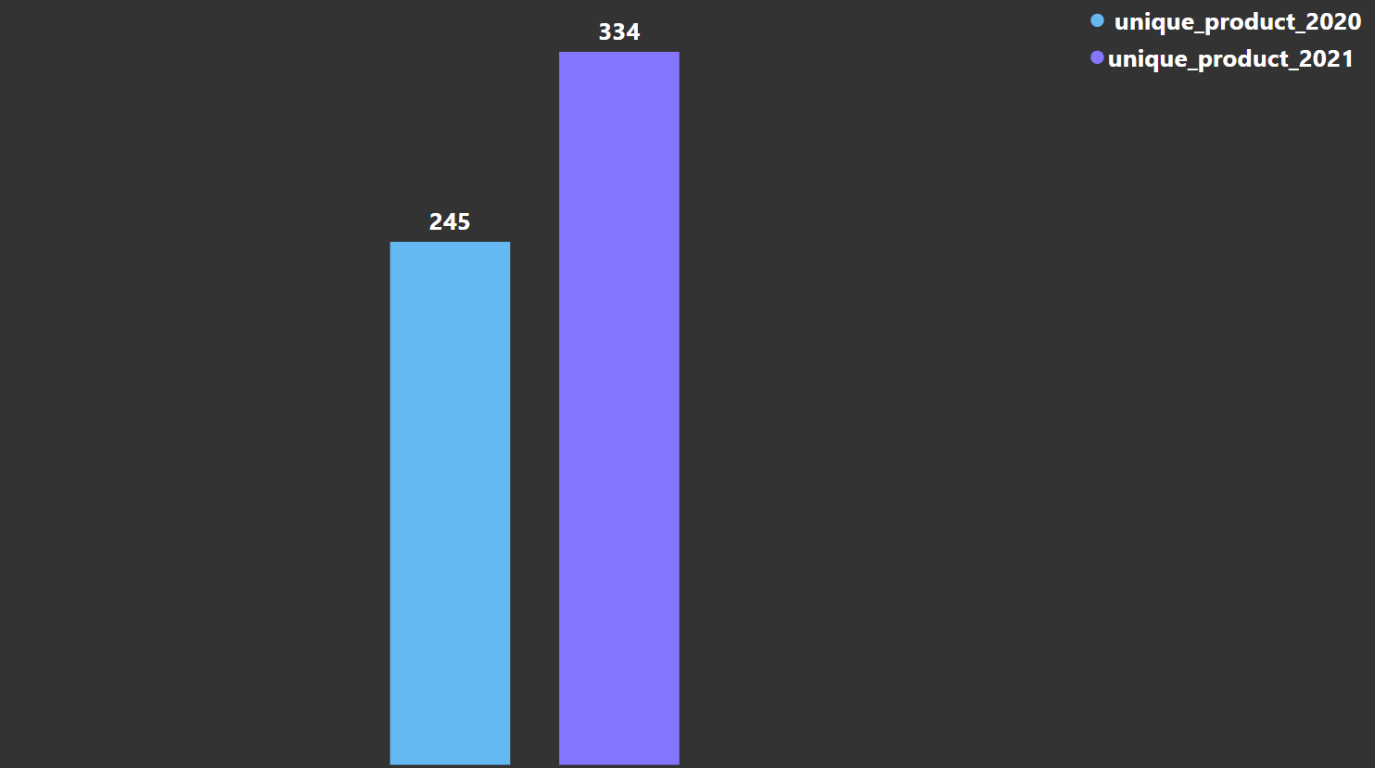
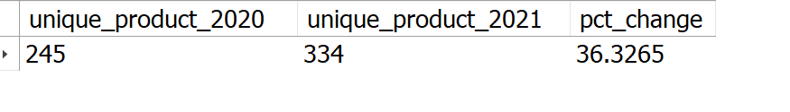
Output
36.33%
1. The number of unique products grew from 245 in 2020 to 334 in 2021, marking a 36.33% increase. 2. This significant increase highlights the company's commitment to innovation and meeting diverse customer needs.
Insights

Slide 12
Requests 3.
Provide a report with all the unique product counts for each segment and sort them in descending order of product counts. The final output contains 2 fields, segment, product_count.
Input
select segment, count(distinct product_code) as Product_count from dim_product group by segment order by Product_count desc ;

Slide 13
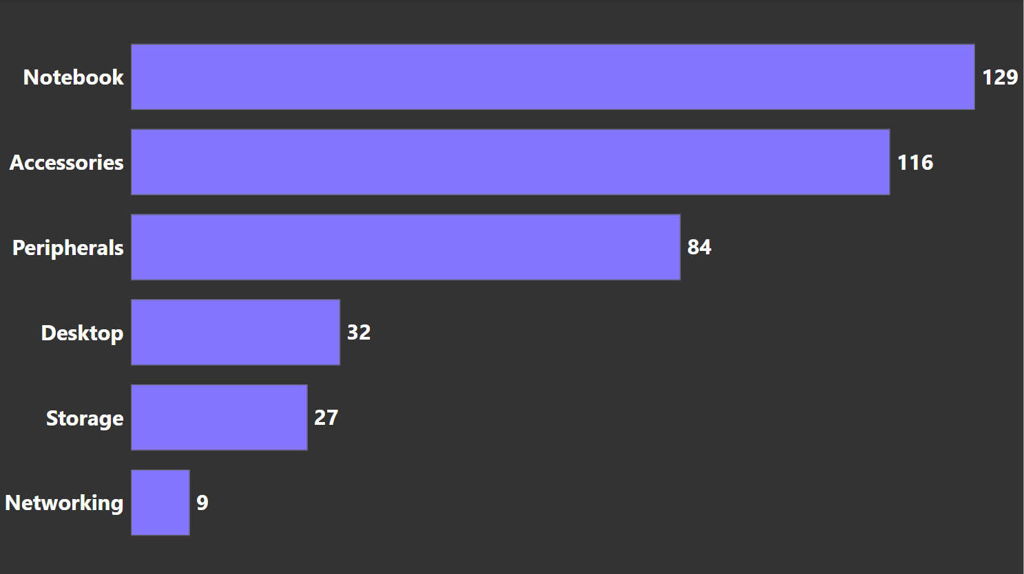
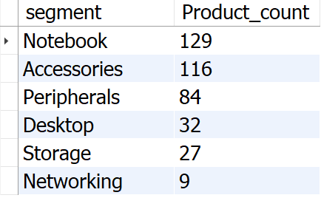
Output
1. AtliQ shines in Notebooks, Accessories, and Peripherals segment, accounting for a whopping 82.87% of product variety. 2. Desktops, Storage, and Networking currently hold a minor share (17.13%) of AtliQ's product portfolio. 3. In Desktops, Storage, and Networking segment AtliQ should focus on products that align with current customer trends and industry demands.
Insights

Slide 14
Requests 4.
Follow-up: Which segment had the most increase in unique products in 2021 vs 2020? The final output contains these fields, segment, product_count_2020, product_count_2021, difference.
with segment_cte as(
select segment, fiscal_year,
COUNT(distinct p.product_code) as product_count
from fact_sales_monthly f join dim_product p on p.product_code = f.product_code group by segment,fiscal_year
)
select segment_2020.segment AS segment,
segment_2020.product_count AS product_count_2020,
segment_2021.product_count AS product_count_2021,
(segment_2021.product_count - segment_2020.product_count) as difference
from
(select segment, product_count from segment_cte where fiscal_year = 2020) as segment_2020
JOIN
(select segment, product_count from segment_cte where fiscal_year = 2021) as segment_2021
on
segment_2020.segment = segment_2021.segment
order by difference desc
Input

Slide 15
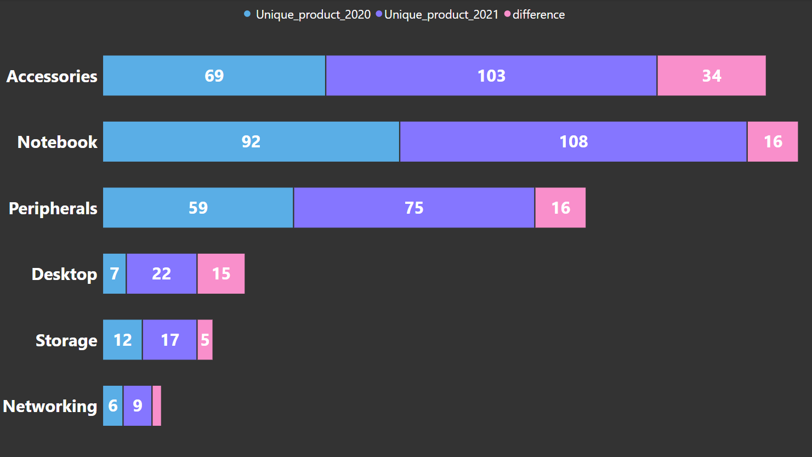
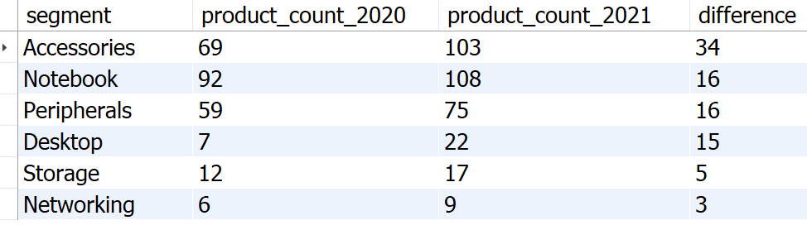
Output
Insights
1. Accessories have the most increased products from 2020 to 2021, with an increase of 34 new products.
2. Desktop products production increased drastically by approximately 214% from 2020 to 2021.
3. Storage and Networking segments are producing the least new products from 2020 to 2021.

Slide 16
Requests 5.
Get the products that have the highest and lowest manufacturing costs. The final output should contain these fields, product_code ,product, manufacturing_cost .
--get lowest and highest manufacturing cost WITH min_max_cost AS (SELECT Min(manufacturing_cost) AS min_cost, Max(manufacturing_cost) AS max_cost FROM fact_manufacturing_cost), lowest_cost_product AS (SELECT f.product_code, p.product, f.manufacturing_cost FROM fact_manufacturing_cost f JOIN dim_product p ON f.product_code = p.product_code WHERE f.manufacturing_cost = (SELECT min_cost FROM min_max_cost)), highest_cost_product AS (SELECT f.product_code, p.product, f.manufacturing_cost FROM fact_manufacturing_cost f JOIN dim_product p ON f.product_code = p.product_code WHERE f.manufacturing_cost = (SELECT max_cost FROM min_max_cost)) --combine all min and max cost SELECT * FROM lowest_cost_product UNION ALL SELECT * FROM highest_cost_product;
Input

Slide 17
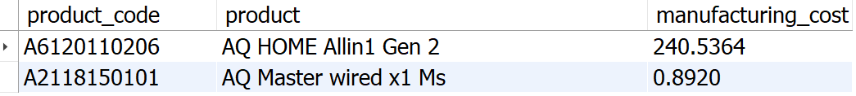


Output
Highest Manufacturing Cost Product
Lowest Manufacturing Cost Product

Slide 18
Requests 6.
Generate a report which contains the top 5 customers who received an average high pre_invoice_discount_pct for the fiscal year 2021 and in the Indian market. The final output contains these fields, customer_code, customer, average_discount_percentage .
Input
SELECT TOP 5 f.customer_code,
c.customer,
Concat(Round(Avg(pre_invoice_discount_pct) * 100, 2), '%') AS
average_discount_percentage
FROM fact_pre_invoice_deductions f
JOIN dim_customer c
ON f.customer_code = c.customer_code
WHERE f.fiscal_year = 2021
AND market = 'India'
GROUP BY f.customer_code,
c.customer
ORDER BY Avg(f.pre_invoice_discount_pct) DESC;

Slide 19
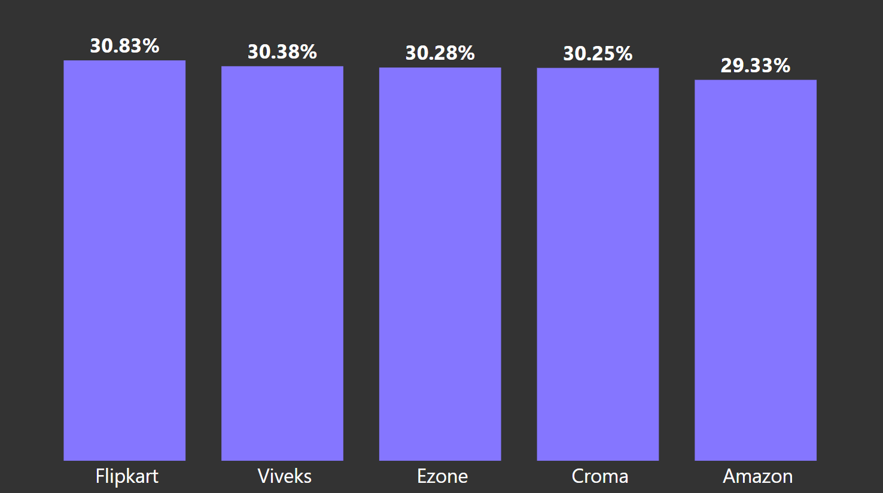
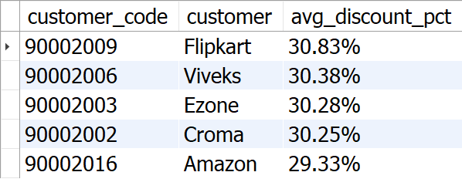
Output
Insights
1. Flipkart leads the list with the highest average discount percentage at 30.83%. 2. AtliQ has provided relatively uniform discount percentages to its top 5 customers, with a narrow range of discounts from 29.33% to 30.83%.

Slide 20
Requests 7.
Get the complete report of the Gross sales amount for the customer “AtliQ Exclusive” for each month. This analysis helps to get an idea of low and high-performing months and take strategic decisions. The final report contains these columns: Month, Year, Gross sales Amount.
Input
SELECT Datename(month, f.date) AS month, Year(f.date) AS year, Sum(f.sold_quantity * g.gross_price) AS gross_sales_amount FROM fact_sales_monthly f JOIN fact_gross_price g ON f.product_code = g.product_code JOIN dim_customer d ON d.customer_code = f.customer_code WHERE d.customer = 'Atliq Exclusive' GROUP BY Datename(month, f.date), Year(f.date) ORDER BY year;

Slide 21
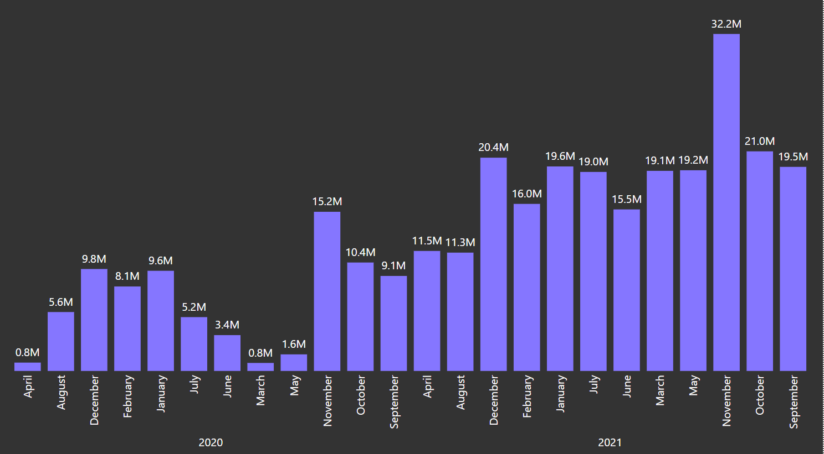
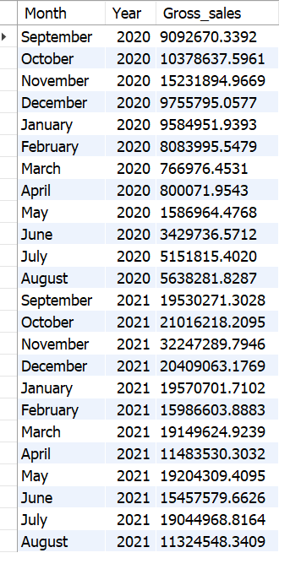
Output
1. March, April, May recorded the lowest sales in 2020, likely due to the COVID-19 pandemic. Sales began to recover after June 2020.
2. November generated the highest sales for 2020, with around 15.23 million.
3. Sales figures in 2021 show significant growth compared to 2020.
4. In 2021, the lowest sales were in August, accounting for 11.32 million, while the highest sales were in November, reaching 32.25 million.
Insights

Slide 22
Requests 8.
In which quarter of 2020, got the maximum total_sold_quantity? The final output contains these fields sorted by the total_sold_quantity, Quarter, total_sold_quantity.
WITH sales_with_quarters AS (SELECT Month(date) AS Month, Year(date) AS Year, sold_quantity, CASE WHEN Month(date) IN ( 9, 10, 11 ) THEN 'Q1' WHEN Month(date) IN ( 12, 1, 2 ) THEN 'Q2' WHEN Month(date) IN ( 3, 4, 5 ) THEN 'Q3' WHEN Month(date) IN ( 6, 7, 8 ) THEN 'Q4' END AS quarter FROM fact_sales_monthly WHERE Year(date) = 2020) SELECT quarter, Sum(sold_quantity) AS total_sold_quantity FROM sales_with_quarters GROUP BY quarter ORDER BY total_sold_quantity DESC
Input

Slide 23
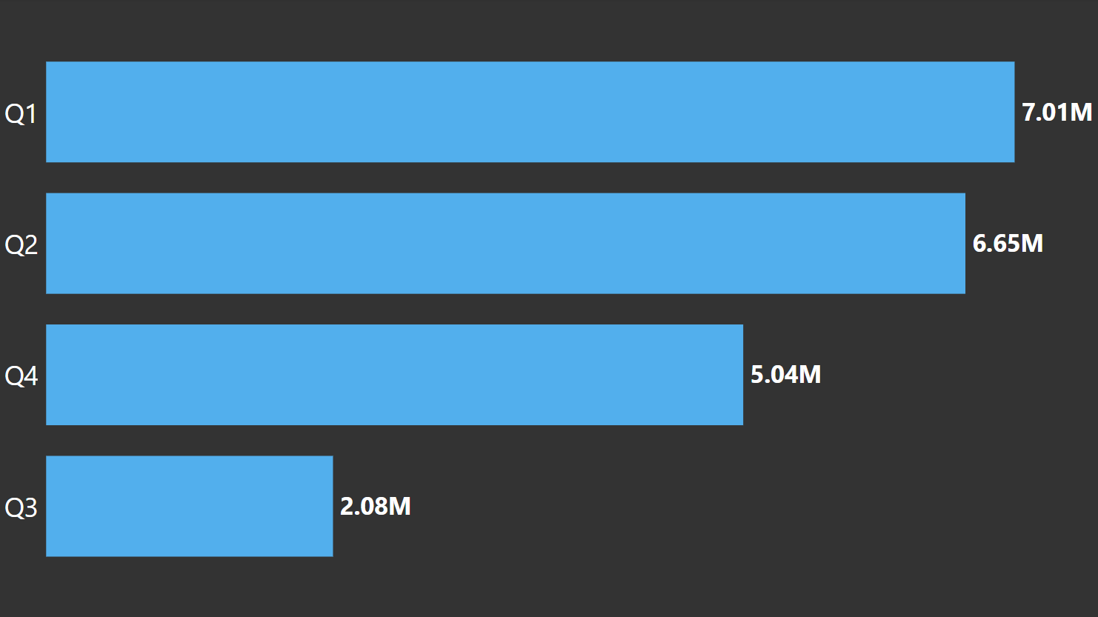
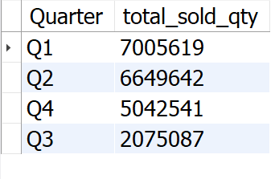
Output
1. Q1 (2020) saw the highest sales volume, reaching around 7 million units, indicating strong performance early in the year. 2. AtliQ experienced a significant decline in sales during Q3 (March, April, May), possibly due to the COVID-19 pandemic, reflecting challenging market conditions and shifting consumer behavior.
Insights

Slide 24
Requests 9.
Which channel helped to bring more gross sales in the fiscal year 2021 and the percentage of contribution? The final output contains these fields, channel, gross_sales_mln, percentage.
Input
WITH gross_sales AS (SELECT channel, Round(Sum(( gross_price * sold_quantity ) / 1000000), 2) AS gross_sales_mln FROM dim_customer dc JOIN fact_sales_monthly fsm ON dc.customer_code = fsm.customer_code JOIN fact_gross_price fgp ON fsm.product_code = fgp.product_code WHERE fsm.fiscal_year = 2021 GROUP BY channel), total_sales AS (SELECT Sum(gross_sales_mln) AS overall_gross_sales FROM gross_sales) SELECT gs.channel, gs.gross_sales_mln, Round(( gs.gross_sales_mln * 100 ) / ts.overall_gross_sales, 2) AS percentage FROM gross_sales gs CROSS JOIN total_sales ts ORDER BY gs.gross_sales_mln DESC

Slide 25
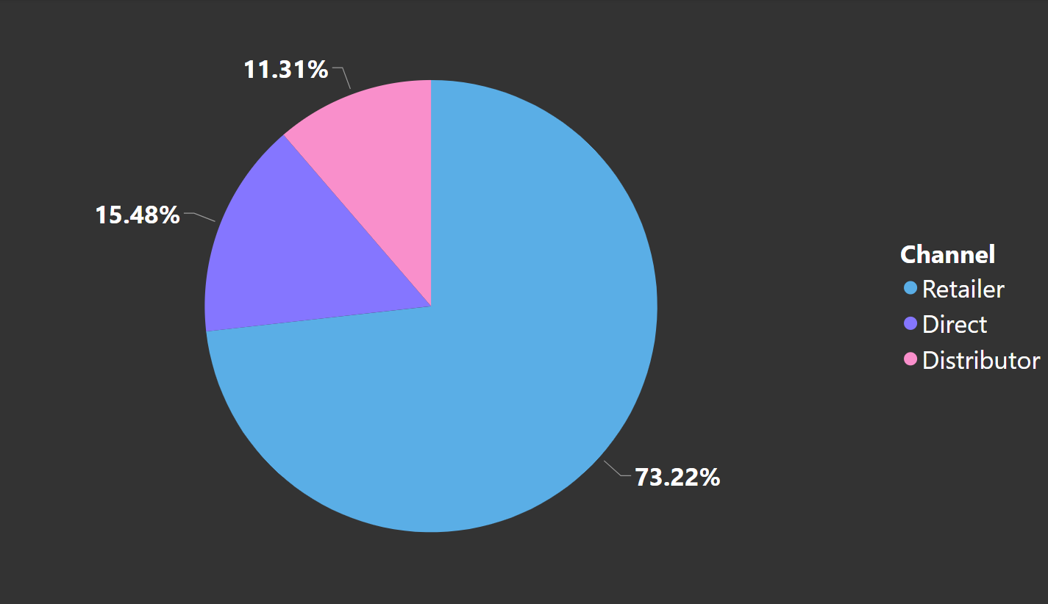
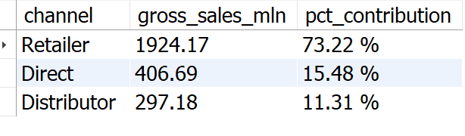
Output
Insights
1. The majority of AtliQ's sales come from retailers, accounting for a substantial 73.22% of the total gross sales. 2. Direct and distributor channel together contributes only 26.79% of the total sales.

Slide 26
Requests 10.
Get the Top 3 products in each division that have a high total_sold_quantity in the fiscal_year 2021? The final output contains these fields, division product_code product total_sold_quantity rank_order.
WITH ranked_products AS (SELECT dp.division, fsm.product_code, Concat(dp.product, '(', dp.variant, ')’) AS product, Sum(fsm.sold_quantity) AS total_sold_quantity, Rank() OVER ( partition BY dp.division ORDER BY Sum(fsm.sold_quantity) DESC ) AS rank_order FROM dim_product dp JOIN fact_sales_monthly fsm ON dp.product_code = fsm.product_code WHERE fsm.fiscal_year = 2021 GROUP BY dp.division, fsm.product_code, product, variant) SELECT division, product_code, product, total_sold_quantity, rank_order FROM ranked_products WHERE rank_order <= 3 ORDER BY division, rank_order;
Input

Slide 27
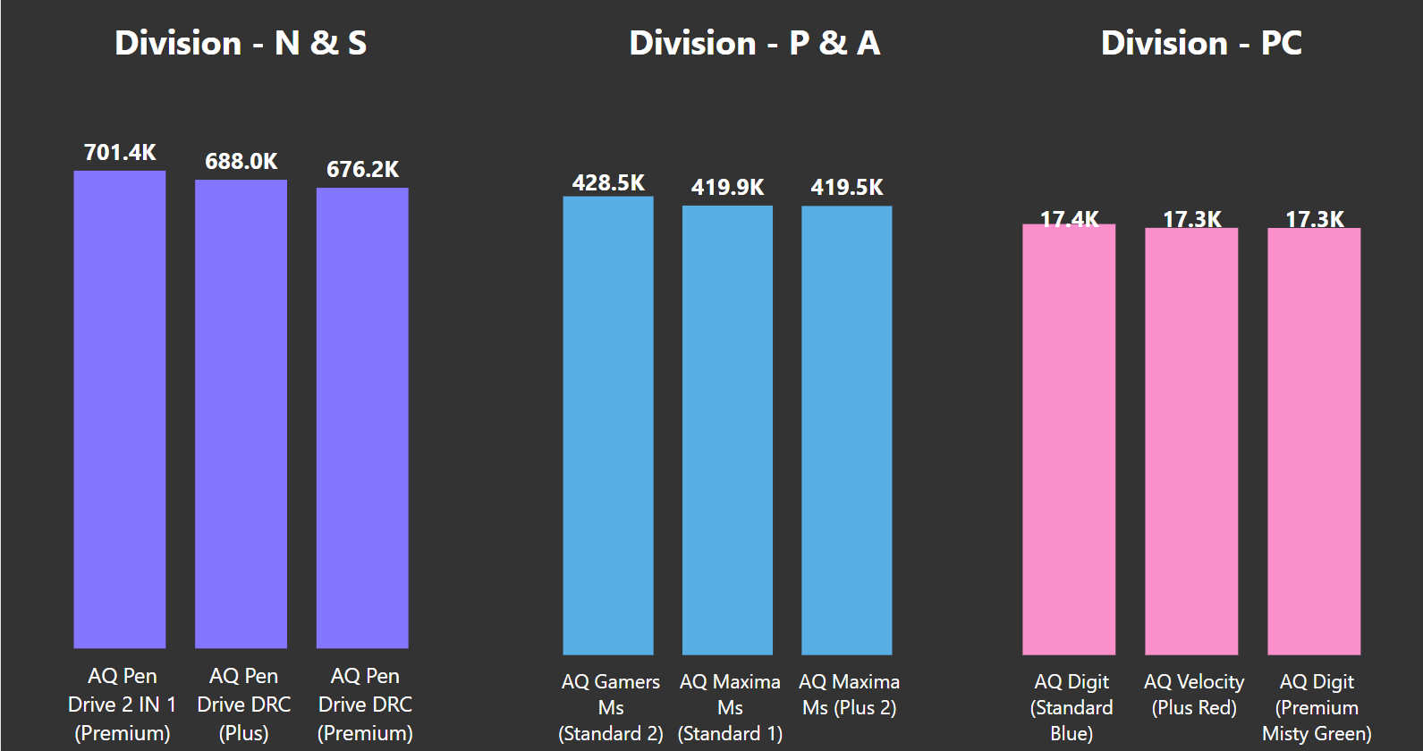
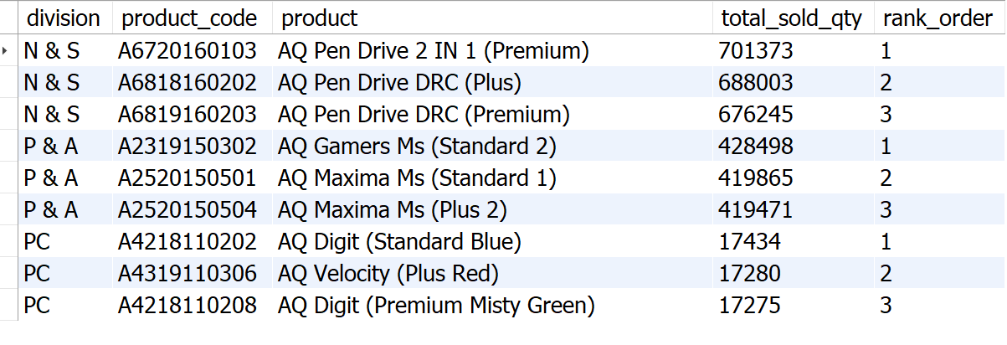
Output
1. In the N & S division, pen drives dominate the top three spots, showcasing their popularity and high sales performance. 2. The P & A division's top three products are exclusively mouse, reflecting a clear demand for these devices. 3. The PC division's bestsellers are all personal laptops.
Insights

Slide 28
Recommendations
1. Focus on desktops, Storage, and Networking segment. 2. Emphasizes multi-channel marketing. 3. Combine pricing strategies with attractive promotions. 4. Continuously improve based on customer feedback. 5. Invest in sales team training for improved performance.

Slide 29
Thankyou!

